Slide 1
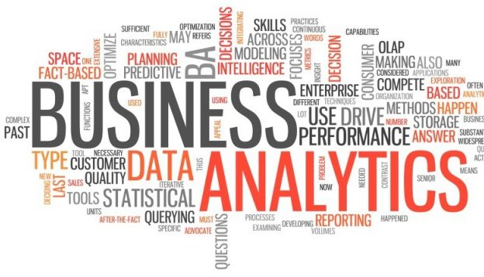
Analytics as a Service

Slide 2
Objective
Subscription based analytic platform providing standard industrial analytics or customer specific analytics.
Supporting any volume of data defined by subscription (Small/Big)

Slide 3
Service Offerings
Packaged BI
Causal Analytics
Advanced forecasting
Predictive modeling
Information Mgmt.
Big data Strategy and Solution
Business Intelligence
Packaged BI
Advanced Analytics
Advanced forecasting
Data Governance
Master Data Management
Country Based Compliance and regulation (Begin with India)
Causal Analytics
Mobile BI
Predictive modeling
What happened?
Why did it happen?
What will happen?
What should I do?

Slide 4
Data Roadmap
Structured Data Source
Semi-structured
Un-structured
Platform

Slide 5
Criteria for Technology Selection
Open Source
Scalability
Proven
Low learning curve
Low Complexity
Easy to maintain
Light weight
Cloud Support
Active Community

Slide 6
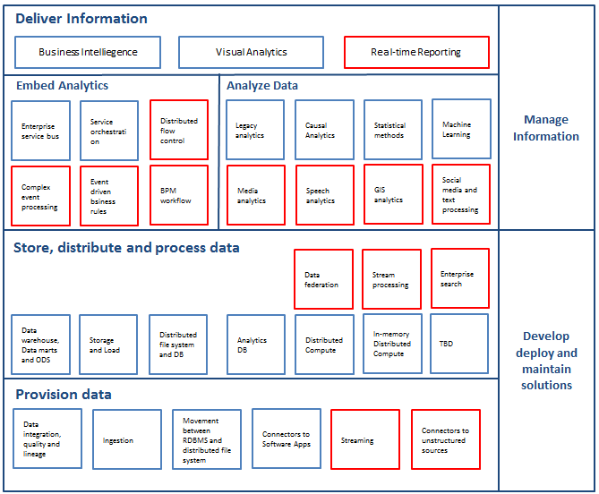
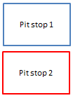
Proposed Architecture

Slide 7
Deliver Information
Visualization
Analyze Data
Statistical
Methods
Machine Learning
Legacy Analytics
Analytics DB
Distributed
Compute
In-memory
Distributed
compute
Store Distribute and Process Data
Ingestion and
Streaming
Data Federation
Stream Processing
Data warehouse
Data Marts
ODS
Storage and Load
Distributed File
system and DB
Analytics DB
Distributed
Compute
In-memory
Distributed
compute
Provision Data
Ingestion and
Streaming
Movement between
RDBMS and
distributed file system
Connectors to
Software apps
Connectors to
unstructured
sources

Slide 8
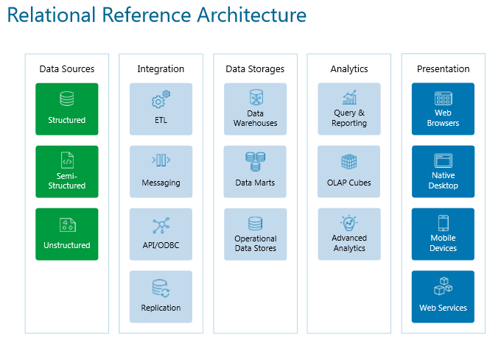

Slide 9
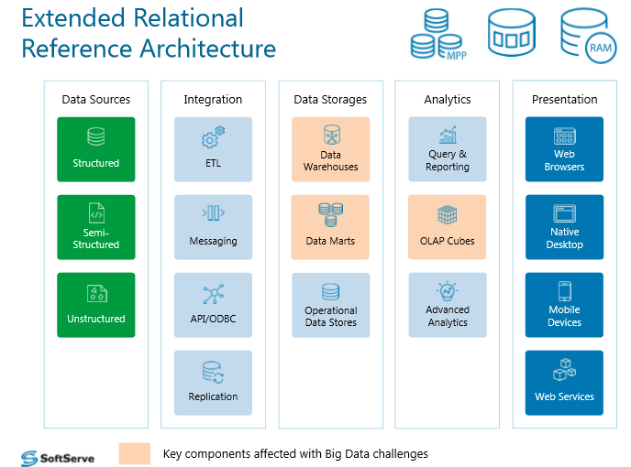

Slide 10
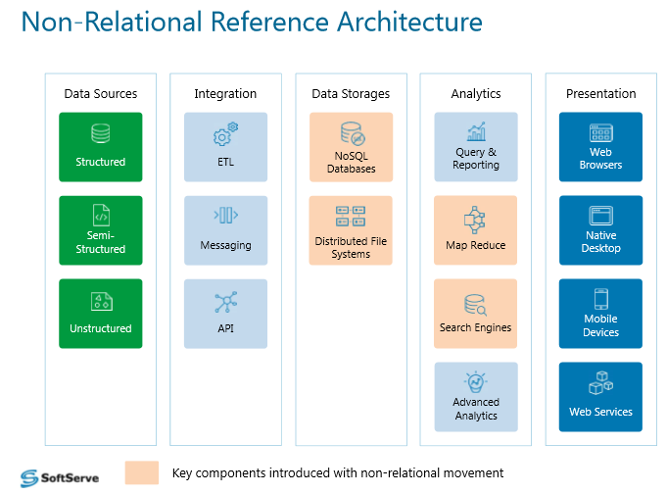

Slide 11
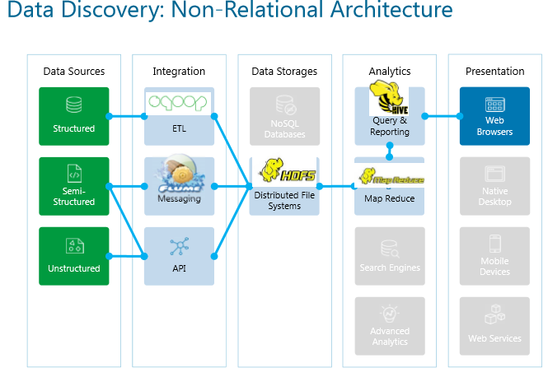

Slide 12
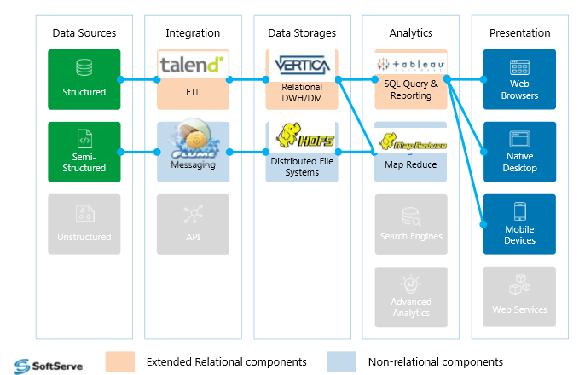
Hybrid Architecture

Slide 13
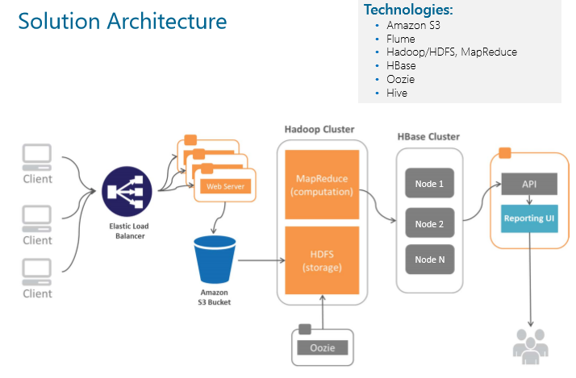

Slide 14
Provision Data
File Type
CSV
Protocol
SSH
Source
(Only when the source is secured for connection for external source)
SQL Server
XML
JSON
FTP
SFTP
HTTP
My SQL
Postgres
URL
Volume
Frequency
AppStore for download
Multi Entity dependency handler
Preliminary file validation
2F Digital Trust
Compression
Encryption
Split
Multiple file hander
OS Support
Authorization
Disconnect/resume connection
Despatcher (Folder structure and file handing principles)
File Size validation based on subscription
File lock
File transfer utility
Digital Certificate
Identity Management
Dependencies

Slide 15
Integration
Data Quality - Type mapping and Cleaning
Metadata
Taxonomy
Linkage
Enrichment
Match and Merge

Slide 16
<>

Slide 17
<>

Slide 18
<>

